Slide 1
Boys Swim and Dive Tickets
Timeline
Monday February 27th - Schools will receive list of passcodes for each ticket they are allotted
Tuesday February 28th - All Swim and Dive tickets will go on sale at 8:00 AM
Wednesday March 1st - All Passcodes for Swim Prelims and Finals will expire at 8:00 AM
Wednesday March 1st - Open Reserved Seating will begin at 12:00 Noon

Slide 2
Boys Swim and Dive Tickets
Code Information
Each code will unlock one ticket in your school’s designated seating section
Each code will be good for both the swim prelims on Friday and the swim/dive finals on Saturday
How you assign these codes are up to you, but your allotted ticket amount is represented by the number of codes you received

Slide 3
Boys Swim and Dive Tickets
Purchase Instructions for Passcode Tickets
Step 1: Go to https://www.mshsl.org/tickets
Step 2: Select the ticket you want to purchase:
Swim Prelims--Friday, March 4 or Swim/Dive Finals--Saturday, March 5
**Be sure to select the correct Class (A or AA)
Step 3: Select Find Seats
Step 4: Enter your 1st code
Step 5: Select your seat in your unlocked section and continue to checkout
Step 6: Purchase Ticket
Step 7: Repeat steps 1 - 6 until all assigned codes have been used.

Slide 4
Boys Swim and Dive Tickets
Purchase Instructions for Passcode Tickets
How To Use Your Codes

Slide 5
Boys Swim and Dive Tickets
Fan Support Information
Fan Support Number-
1-866-488-4849
Fan Support email-
fansupport@hometownticketing.com

Slide 6
Boys Swim and Dive Tickets
Nicholas Rizzo
Client Success Manager, Associations
Work Mobile: (614) 964-2809
nick.rizzo@hometownticketing.com

Slide 7
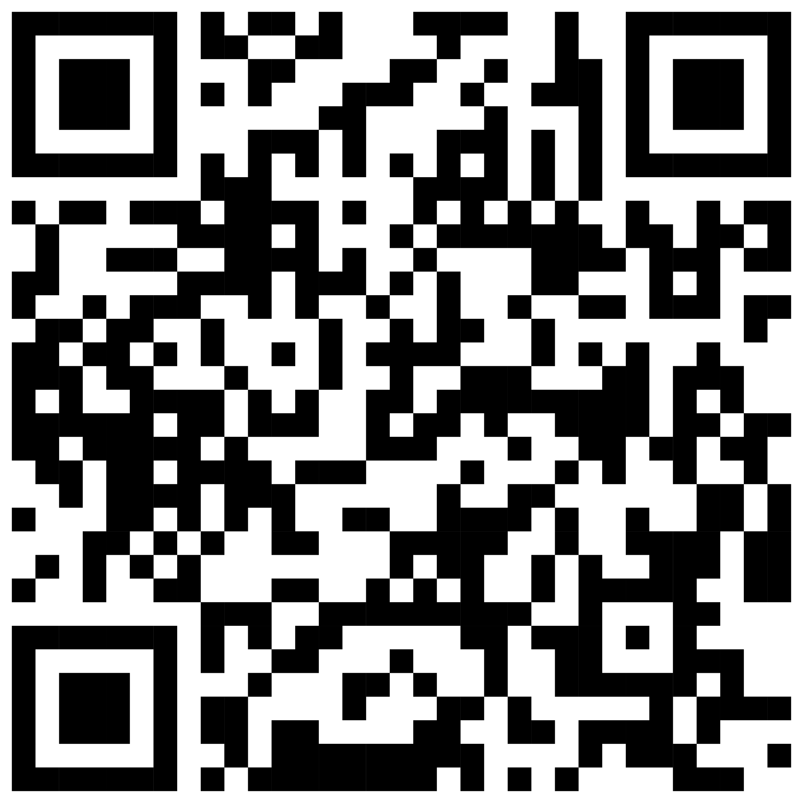
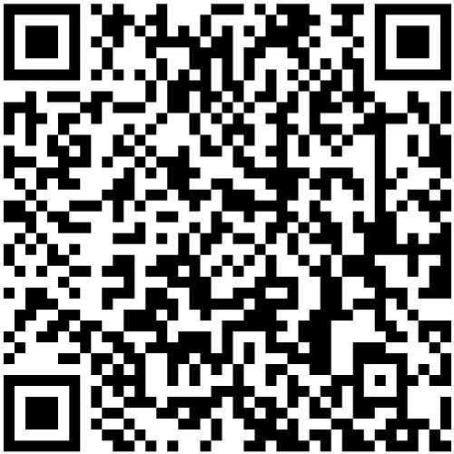
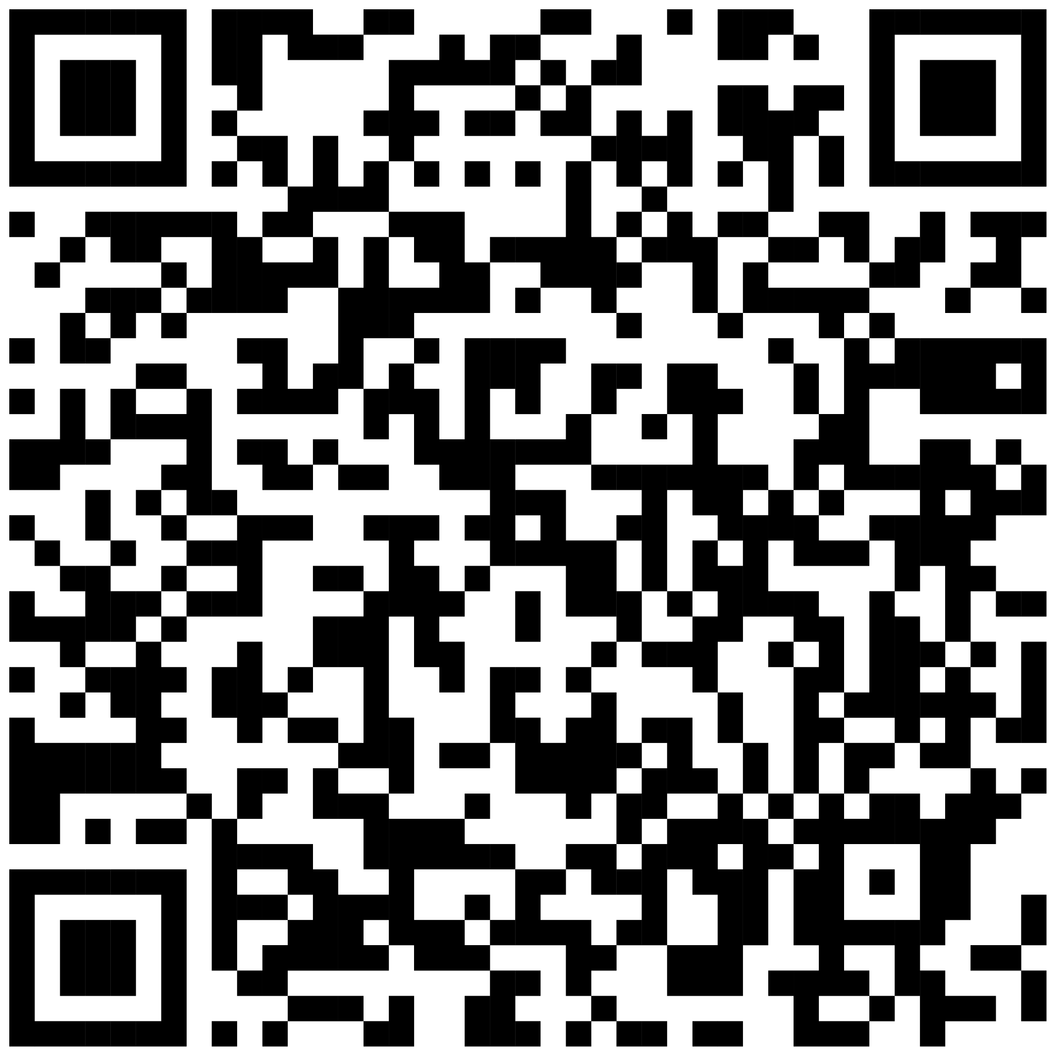
HomeTown Gate App
HomeTown Fan App
iPhone
or iPad
Scan Here
iPhone
or iPad
Scan Here
Android
or Tablet
Scan Here
Android
or Tablet
Scan Here
Scan digital or printed tickets from your mobile device.
Easily buy and store your digital tickets to school events.

