Slide 1
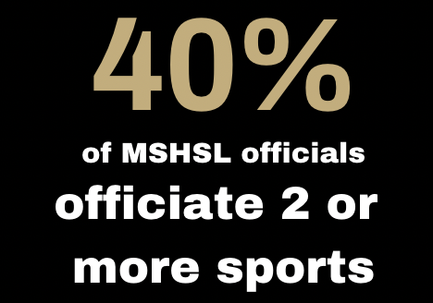
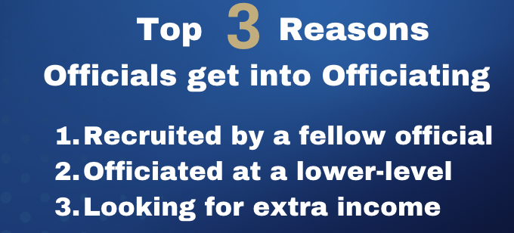
Officials are part of a team that helps keep activities safe, fair and fun.
Contests can only happen when we have eligible officials.
Officials strive to give their best effort at every contest.
Spectators at our school are expected to respect officials at every contest.
Insert your school logo here.

